Slide 1
Art & the Environment Lesson 1: Landscapes of the Past
www.albanyinstitute.org

Slide 2
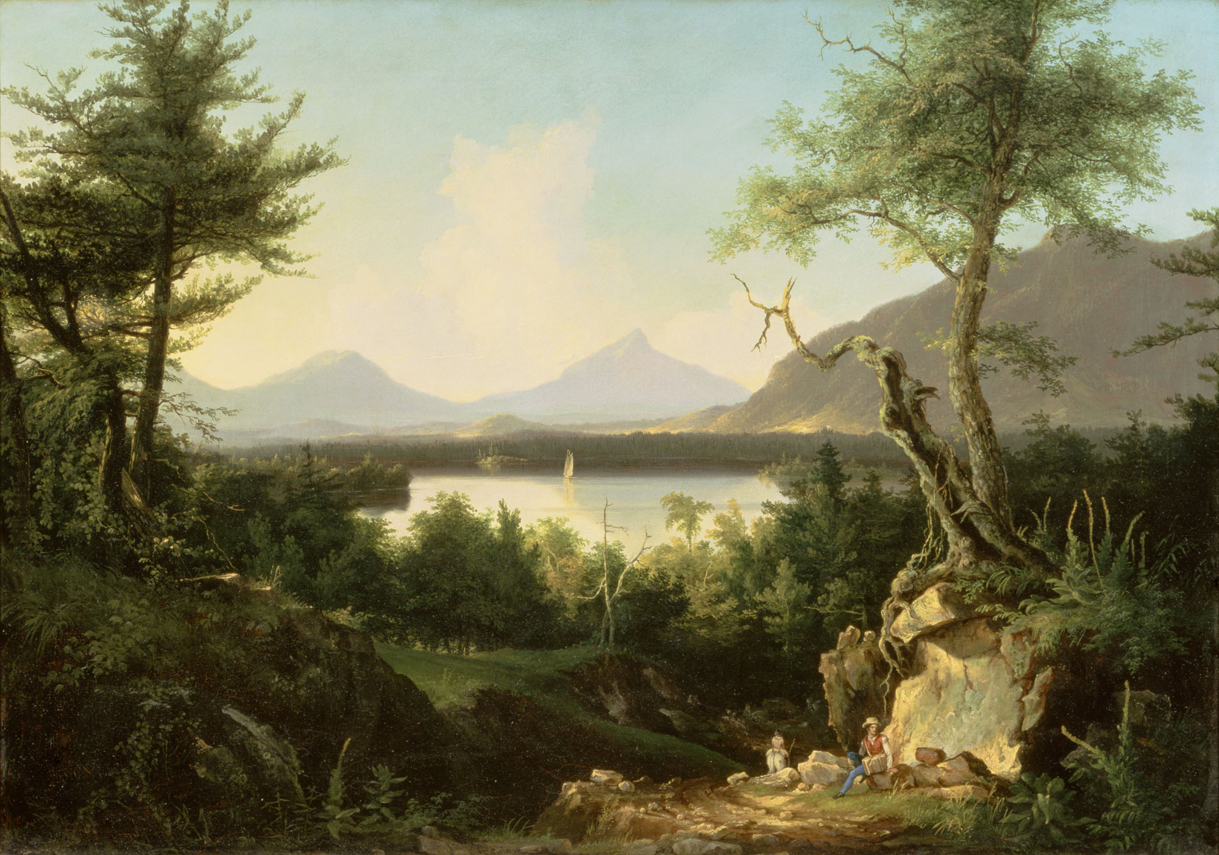
The Hudson River School America’s First Art Movement
American landscape paintings
1825-1875
Not a formal “school”
Informal group of artists who lived and worked in Hudson Valley
Artists worked and exhibited in the same venues
Lake Winnepesaukee, 1827 or 1828
Thomas Cole (1801-1848)
Gift of Dorothy Treat Arnold Cogswell, Jr., 1949.1.4

Slide 3
Before the Hudson River School

Slide 4
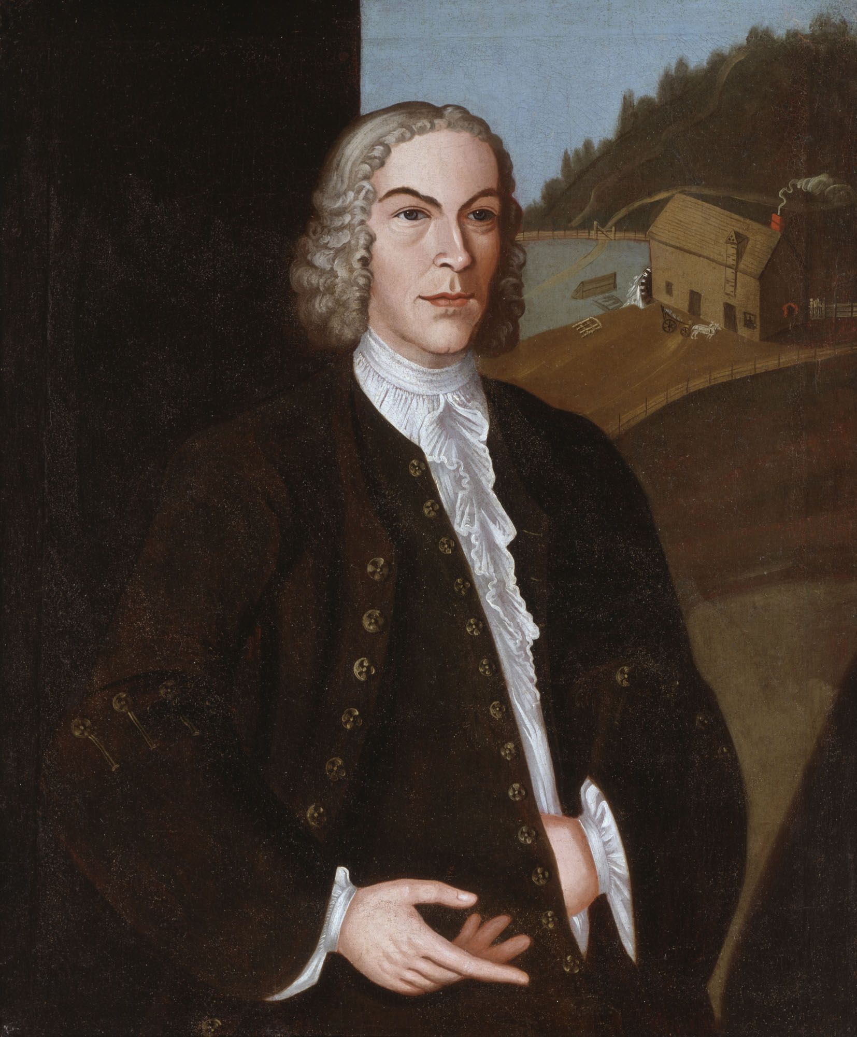
During 1600s and 1700s portraits were most popular style of painting.
Why?
Human control over the natural world.
Landscapes were not considered important enough to paint.
Abraham Wendell, c. 1737
John Heaten (active c. 1730-1745)
Gift of Governor and Mrs. W. Averell Harriman,
Dorothy Treat Arnold (Mrs. Ledyard) Cogsell, Jr.,
Gates B. and Bessie DeBeer Aufsesser and Richard
C. and Marjorie D. Rockwell, 1962.47

Slide 5
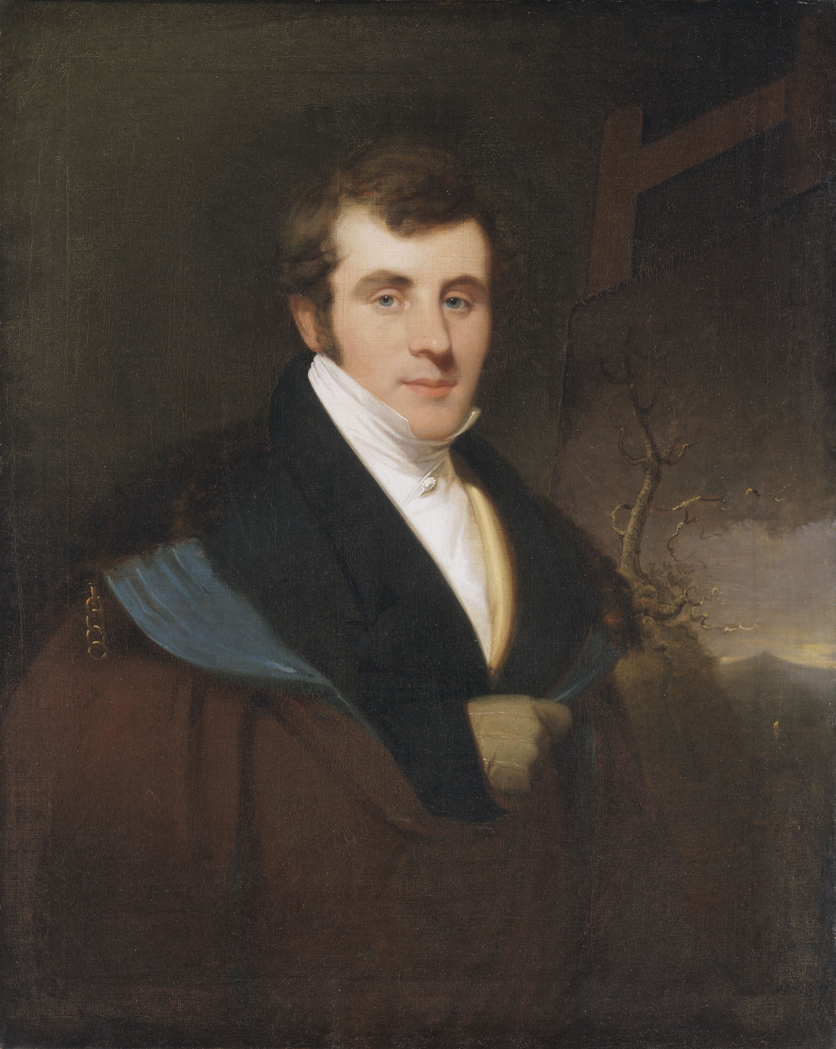
Thomas Cole is considered the “founder” of the Hudson River School because he popularized landscape painting in 1825.
Born in England, came to the United States with his family in 1818.
Moved to Catskill, NY in 1827
Loved nature and the American wilderness (especially the Catskill Mountains).
Thomas Cole, 1826-1828
Thomas Seir Cummings (1804-1894)
Bequest of Mrs. Florence H. Cole Vincent, 1962.51

Slide 6
Notable Artists

Slide 7
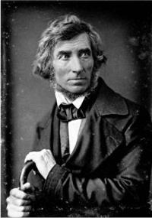
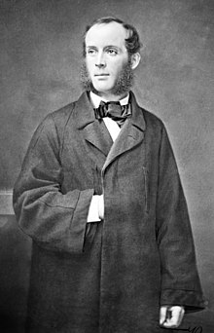
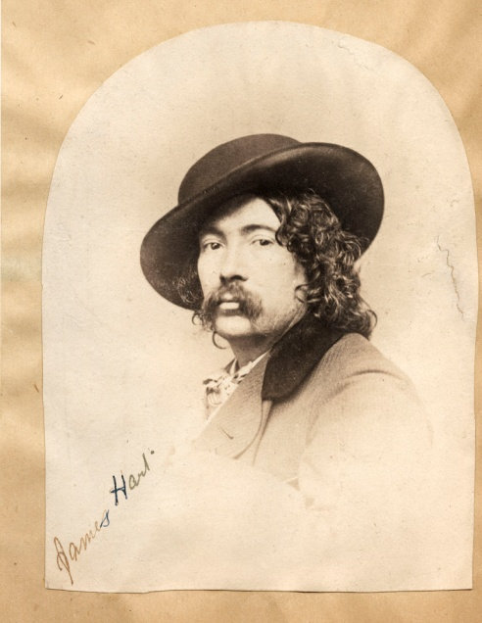
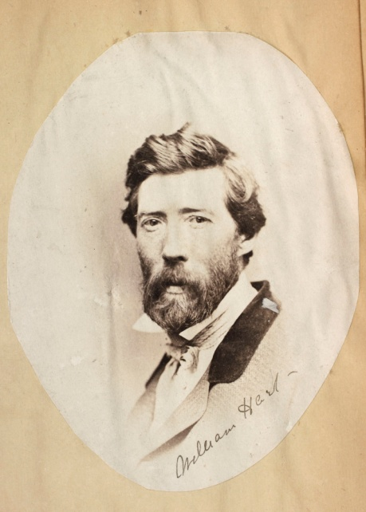
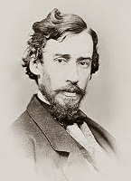
Asher B. Durand
Frederic Church
James and William Hart
Sanford Gifford

Slide 8
Elements of HRS Paintings

Slide 9
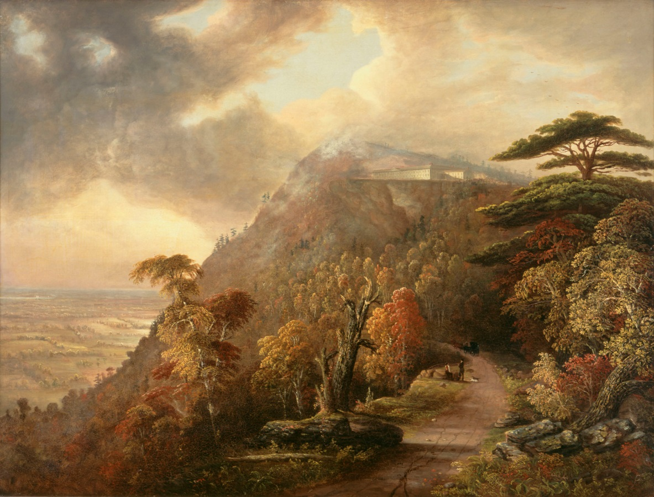
Dramatic views of nature
Realistic, not abstract
People small in scale
Show how humans change landscape
Cut down tree
Dirt path
Do you see any others?
Catskill Mountain House, 1845
DeWitt Clinton Boutelle (1820-1884)
Albany Institute of History & Art, 1975.20
Notes:
Scenic Nationalism
“I would have it remembered that nature has shed over this land beauty and magnificence, and although the character of its scenery may differ from the old world's, yet inferiority must not therefore be inferred; for though American scenery is destitute of many of those circumstances that give value to the European, still it has features, and glorious ones, unknown to Europe.”

Slide 10
Analyze a Painting

Slide 11
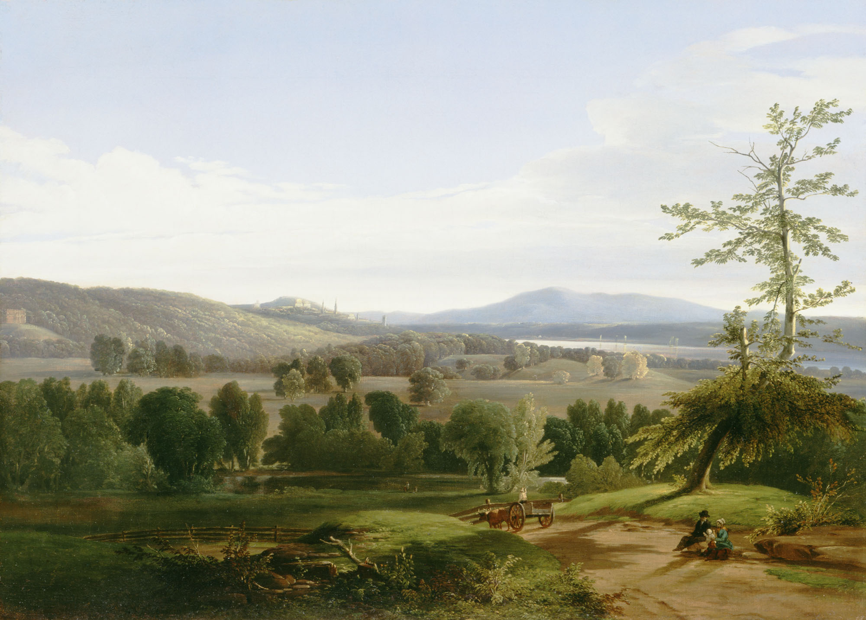
1
2
3
4
A Distant View of Albany, 1848
William Hart (1823-1894)
Albany Institute of History & Art, 1942.74

Slide 12
Hudson River School artists were not the only ones who documented the landscape of the Hudson Valley. Can you think of any other reason why people would want to depict the landscape of this region?
Create maps
Promote tourism and travel
Military and defense plans
Scientific or environmental studies
Illustrations in books and other publications
Analyze the next four images and answer the questions on your worksheet.

Slide 13
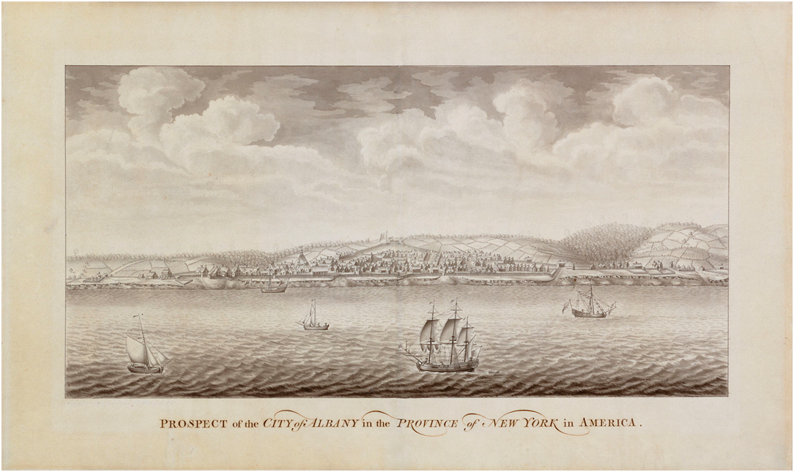
Prospect of the City of Albany in the Province of New York in America; Attributed to Thomas Davies probably after an original drawing by William Burgis, Ink wash on paper, c. 1760, Gift of Mrs. Richard C. Rockwell, 1980.17

Slide 14
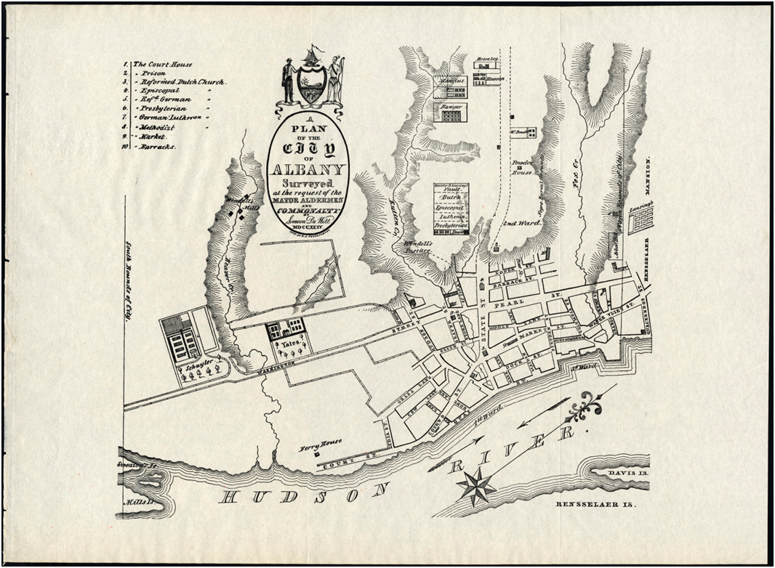
A Plan of the City of Albany; Engraved by R.H. Pease, Albany, NY, Lithograph on paper, 1794, Map 8

Slide 15
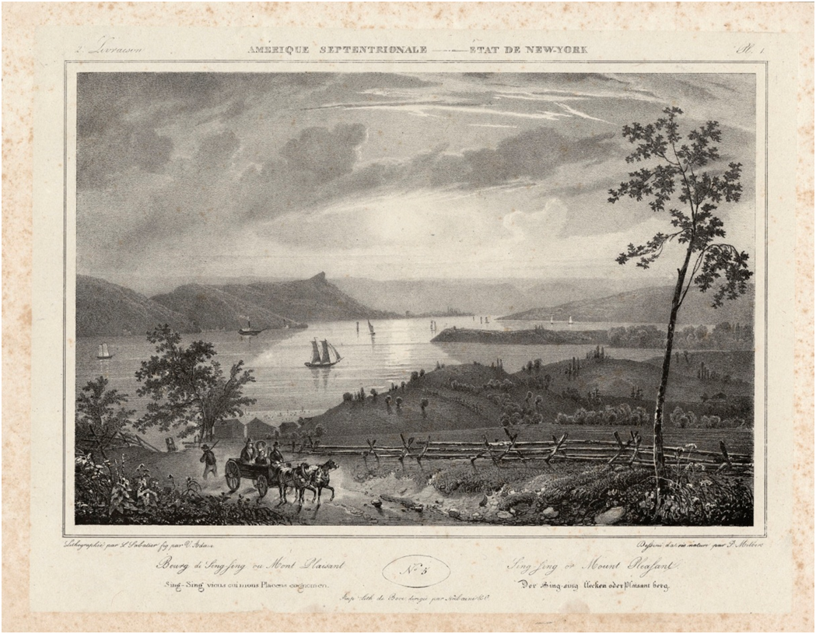
Sing Sing or Mount Pleasant; Jacques-Gérard Milbert, 1829, lithograph from Itinéraire Pittoresque du fleauve Hudson et des Parties Laterals, 1944.22.5

Slide 16
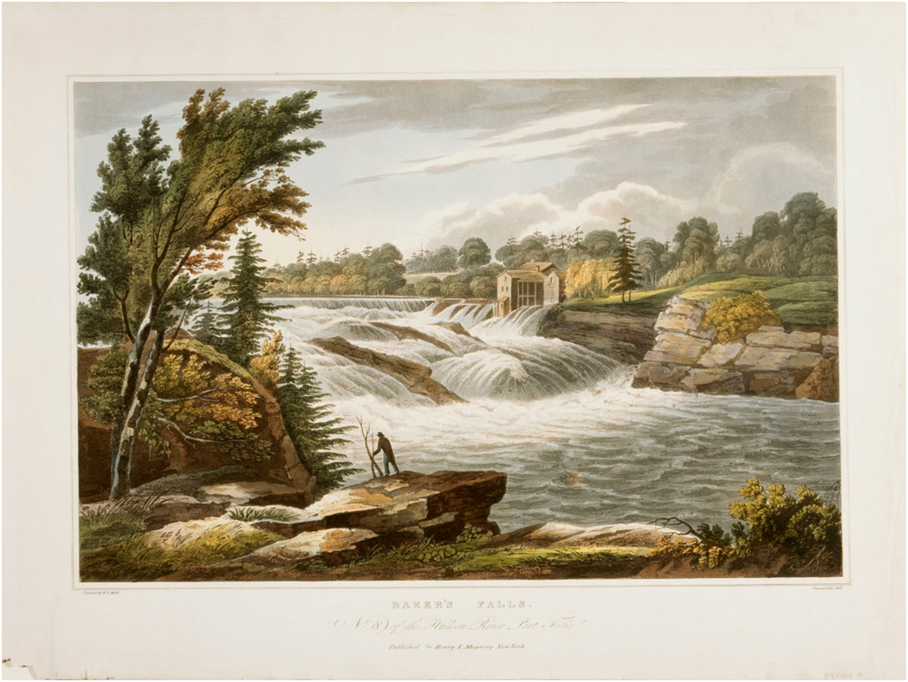
Baker’s Falls; Drawn by William Guy Walls (1792-c.1864), Engraved by John Hill (1770-1850), Colored aquatint, 1822-1828, 1983.23.1

